Slide 1
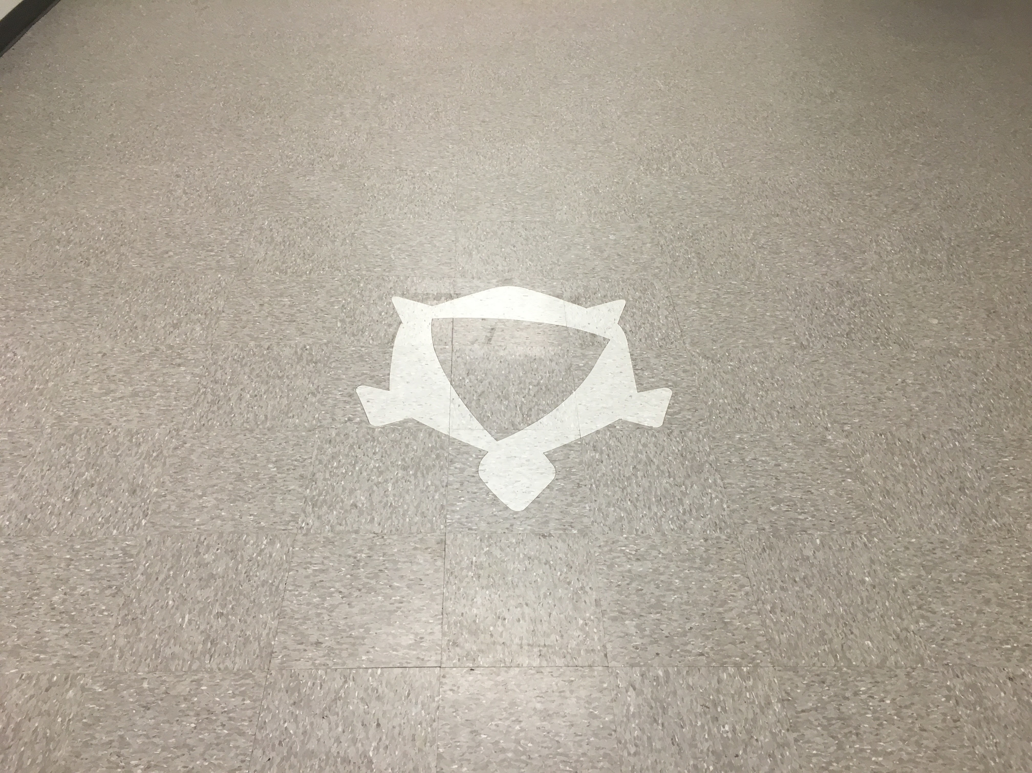
Black Turtle
McAllen

Slide 2
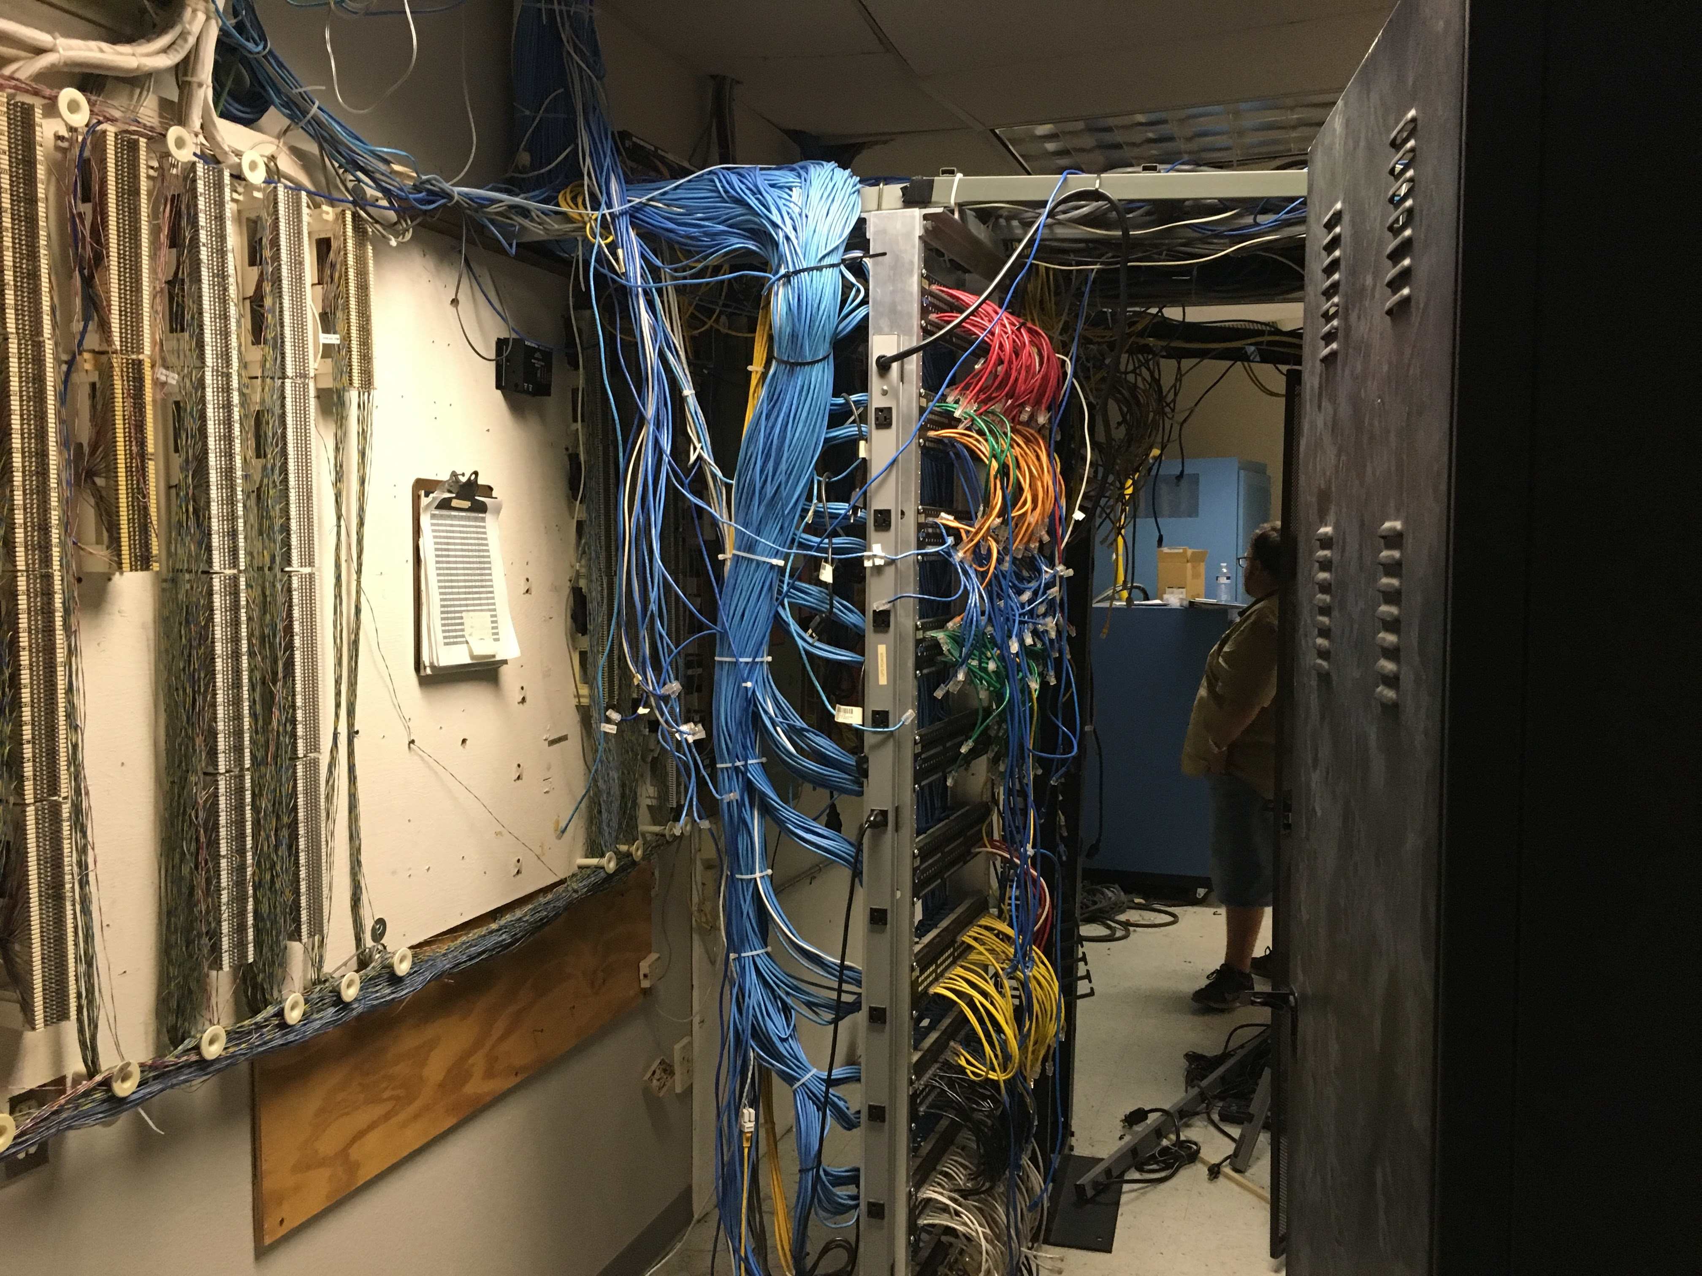
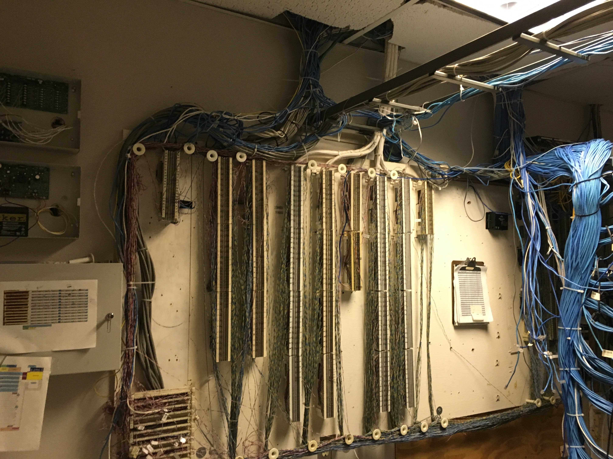
Before
Wires were coming out of the ceiling, not using the wire tray, and plugged into a slower outdated punch down's.

Slide 3
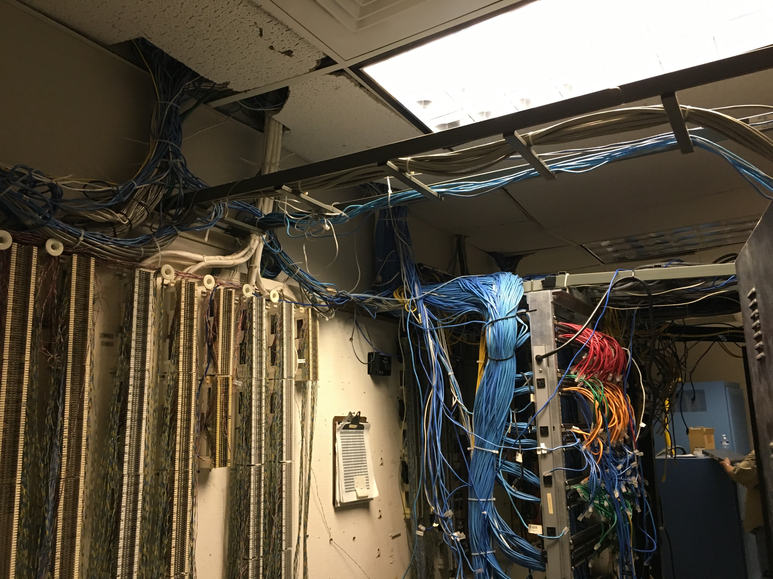
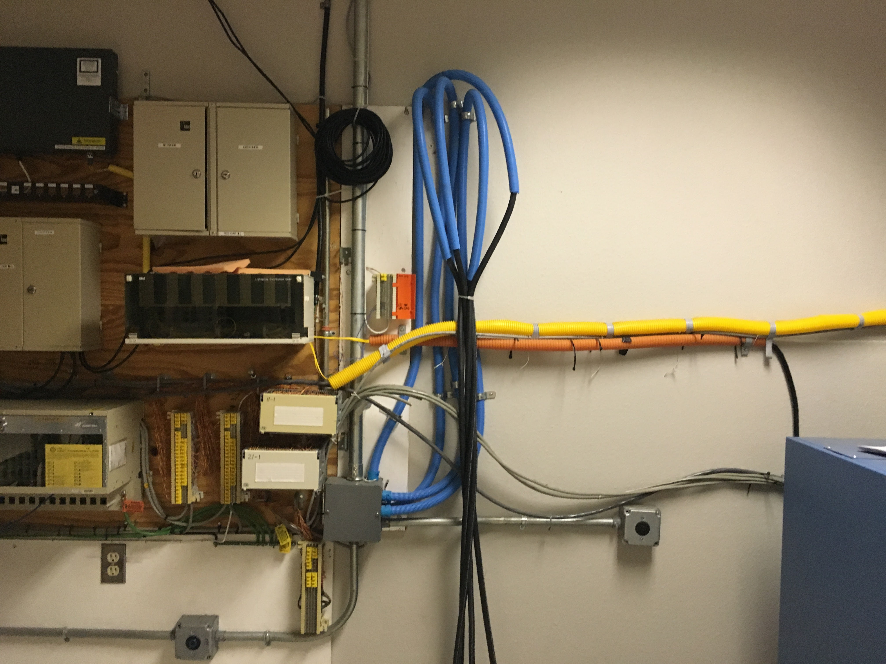
Another view of old punchdowns on the wall, and cable management that needed a serious upgrade

Slide 4
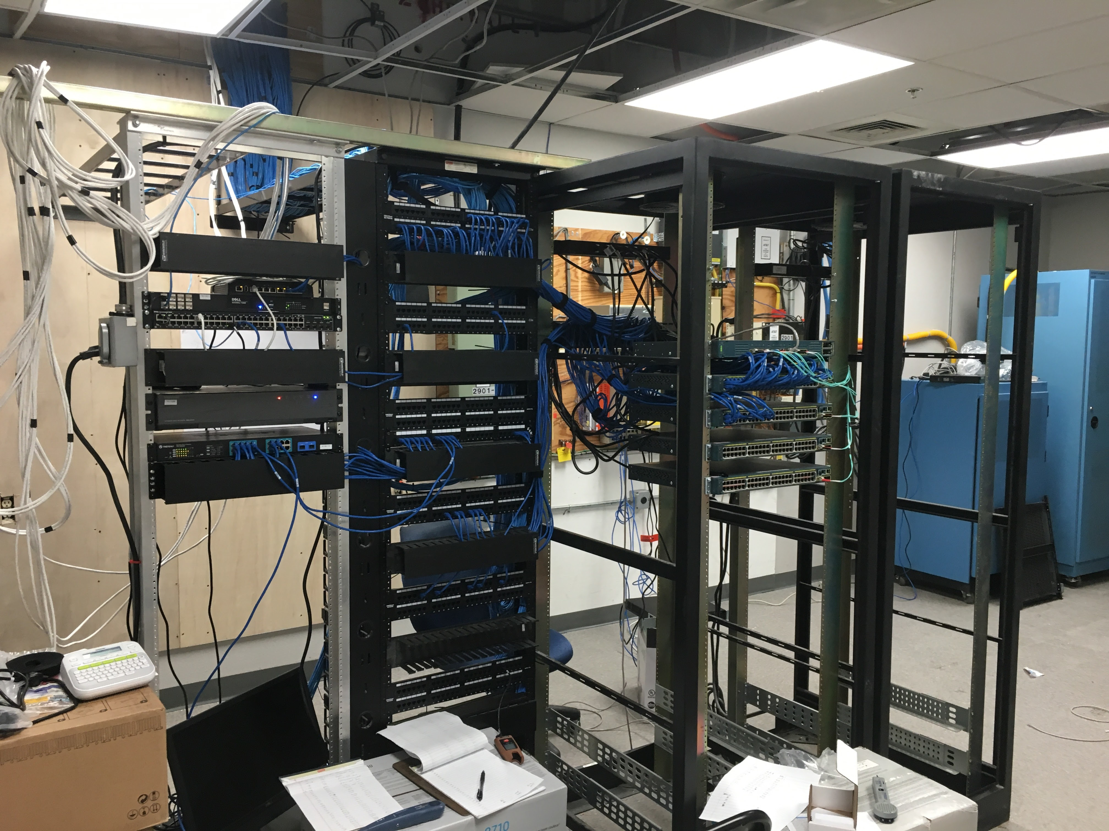
After
Newer, high speed punch downs installed, with cable management to provide a clean look and feel to the server room.

Slide 5
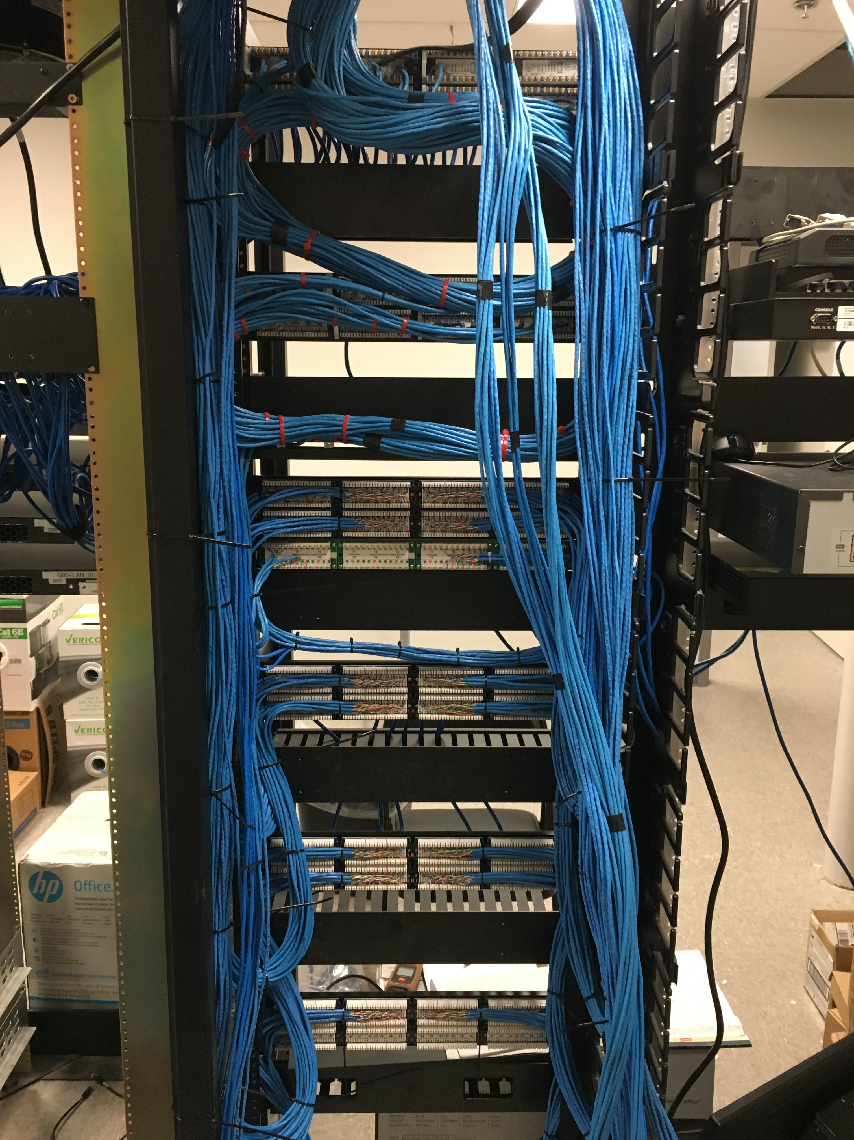
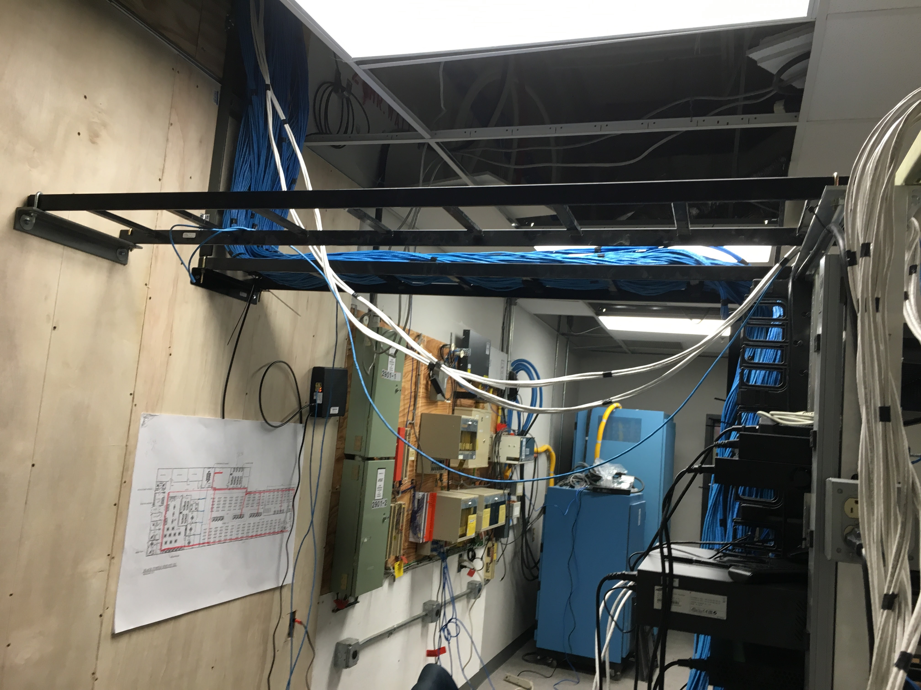
Cables coming in, clean and utilizing the cable trays efficiently.
Clean crisp punchdowns, with wiring that is managed correctly

Slide 6
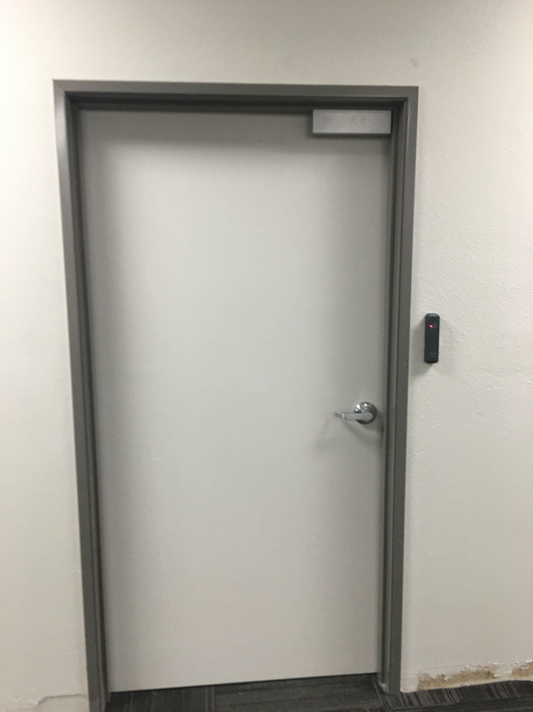
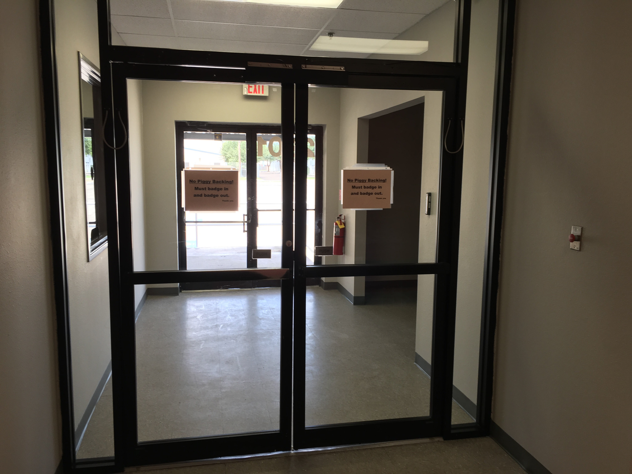
Security System
Exterior doors are now secure with Mag Locks that allow a punch in and punch out system.

Slide 7
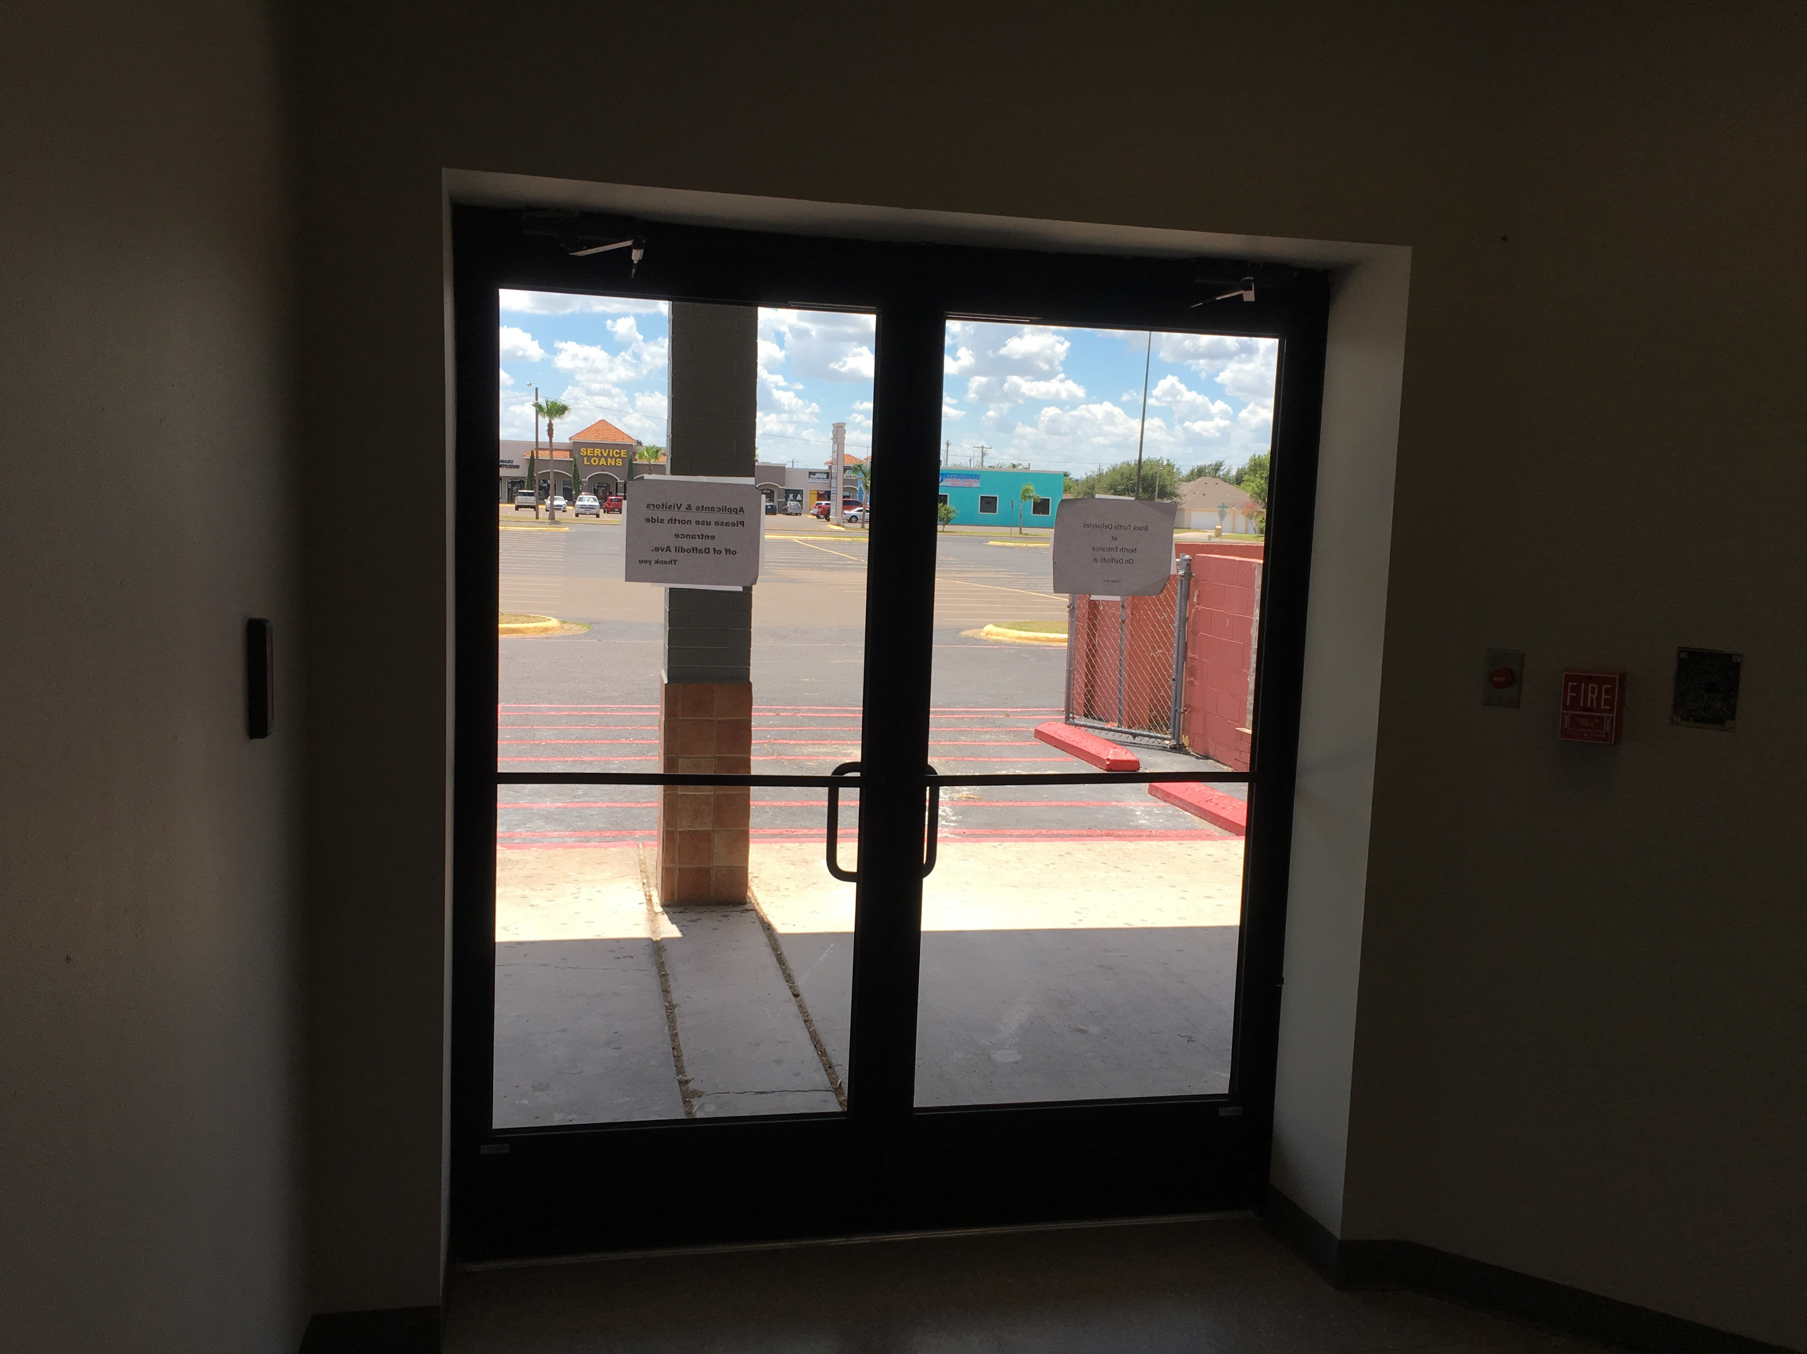
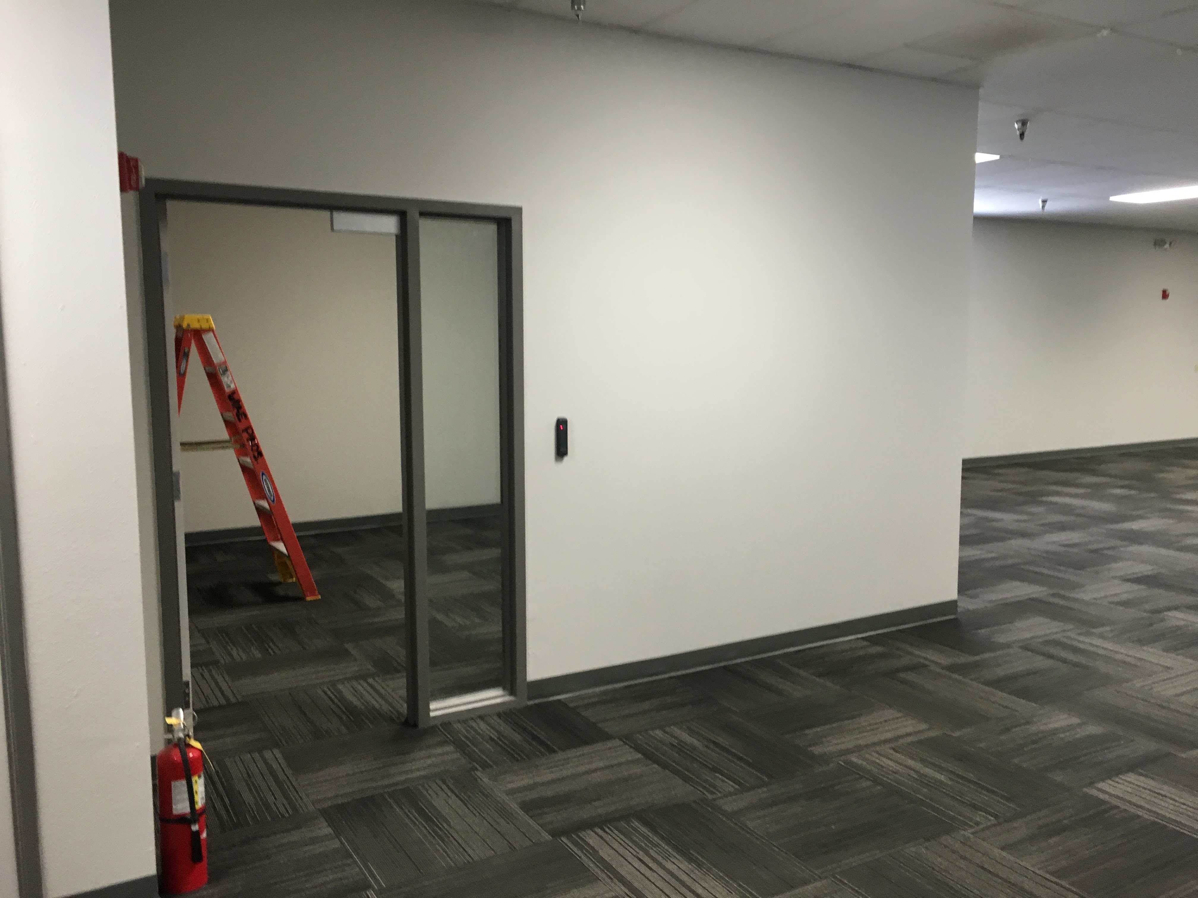
Exterior doors are now secure with Mag Locks that allow a punch in and punch out system.
Offices that need security also have been added.

Slide 8
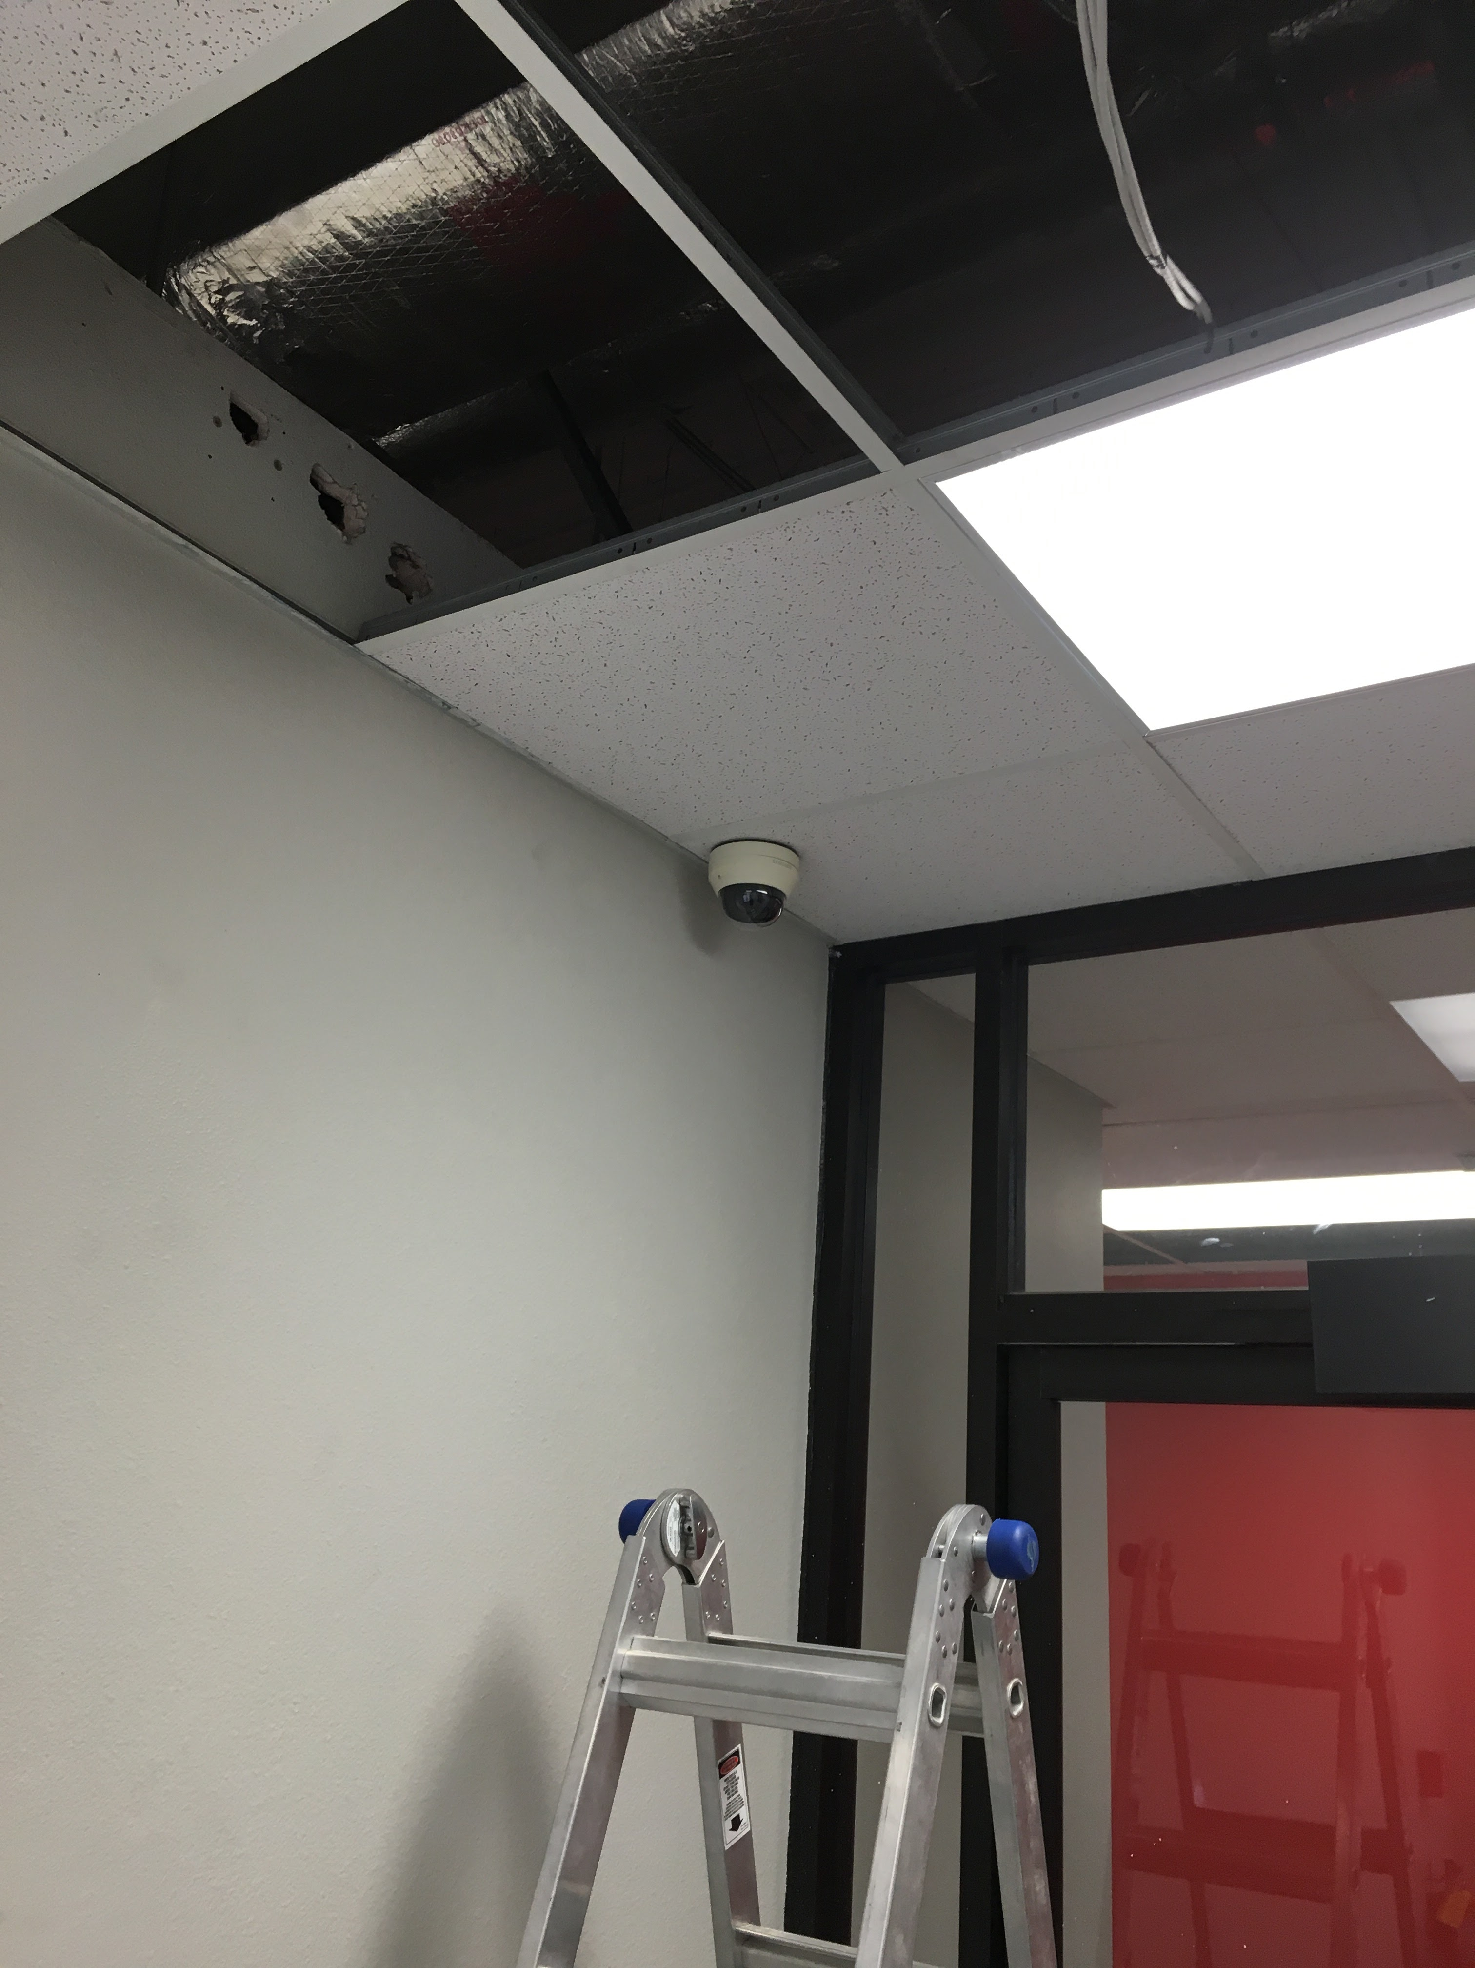
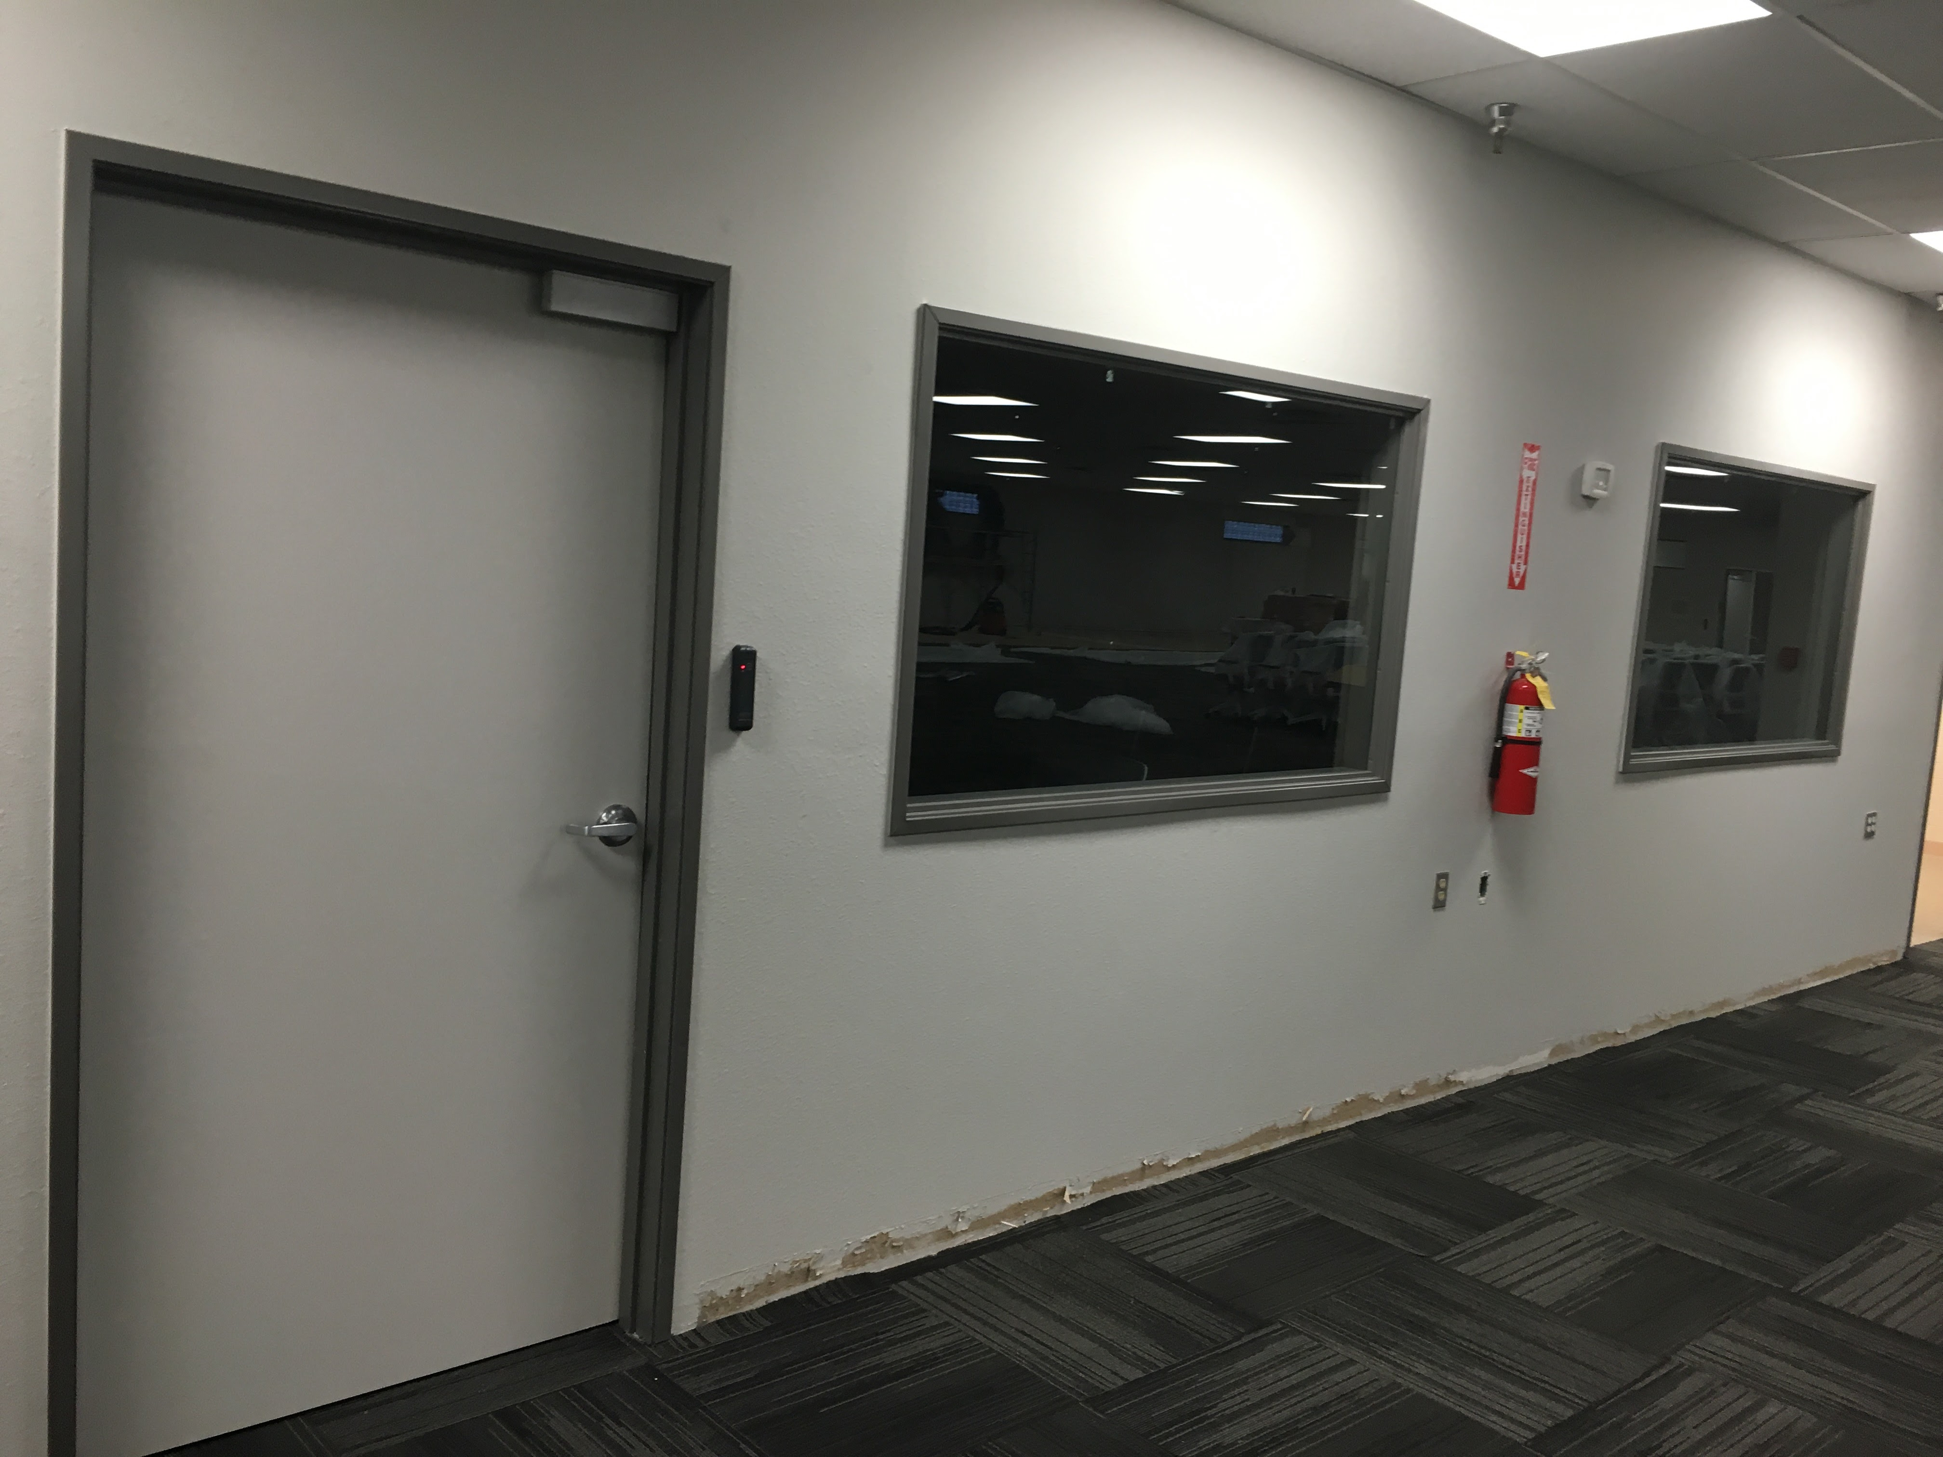
Security Camera’s on all entrances and parking lots are installed. Breakroom camera also installed for safety with lockers.
Training room and CSRA secure room also have security door systems with mag locks. Both Camera and Security systems are upgradeable to allow more devices
to be added.

Slide 9
Thank you!!
SOS Support

